Slide 1
Digitalization:
Disintermediation or the
Democratisation of Financial Services?
Ronald A. Fons
Global Head, Financial Services Sector
ronald.fons@huawei.com

Slide 2


The Opportunity: The Beginning of the Democratisation of Financial Services
Mandatory
Open APIs
Payment Services Directive 2 (PSD2)
The Open Banking Standard
By Q1 of 2018, European banks have to completely open up their data through full APIs. Europe’s Payment Services Directive (PSD2) and Access to Accounts (XS2A) are already mandating that financial institutions give customers and third-party integrators programmatic access (typically API-based) to their data. It’s entirely possible that the question of when to enter the mature API market may be taken out of players’ hands
HM Treasury (UK) announced its commitment to delivering an open standard for Application Programming Interfaces in UK banking, to help customers have more control over their data and to make it easier for financial technology companies (FinTechs) or other businesses to make use of bank data on behalf of customers in a variety of helpful and innovative ways. The Government explained that this could help to drive more competition in banking to improve outcomes for customers, and further support the UK’s world-leading FinTech industry.

Slide 3
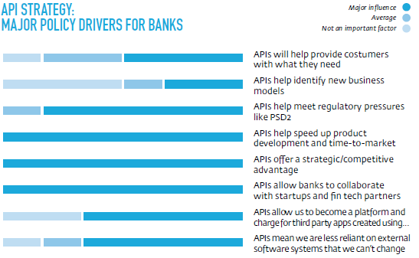
Opportunity API Strategy: Major Policy Drivers for Banks
Source: Axway, Banking APIS State of the Market, 2016

Slide 4
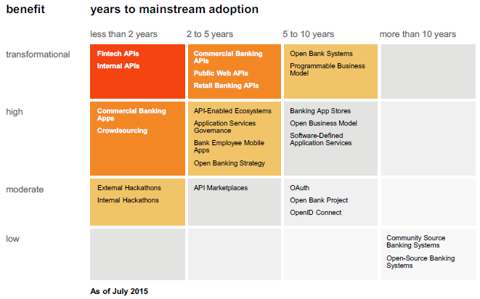
Opportunity: Market Perspective – Priority Matrix
(2017)
(2017-20)
Source: Gartner, Hype Cycle for Open Banking APIs, Apps and App Stores, 2015

Slide 5
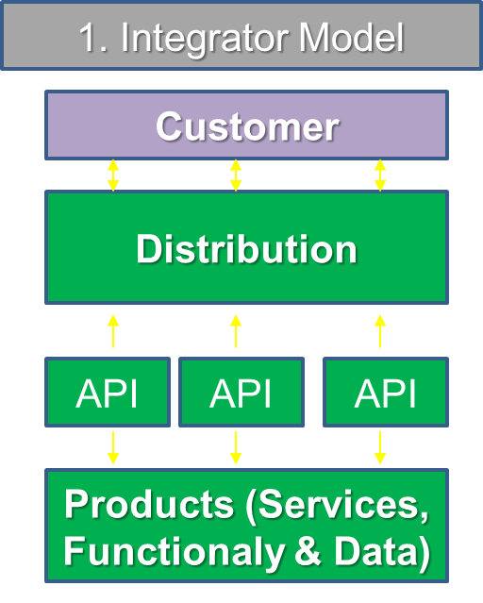
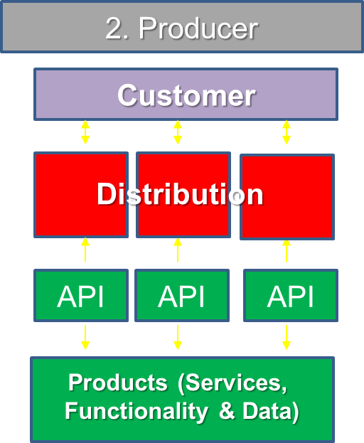
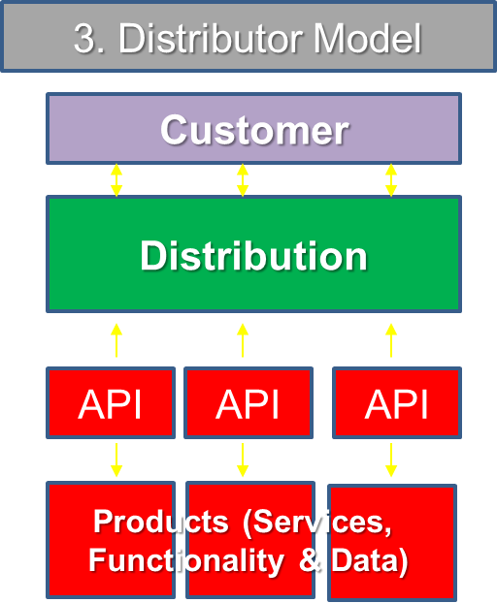
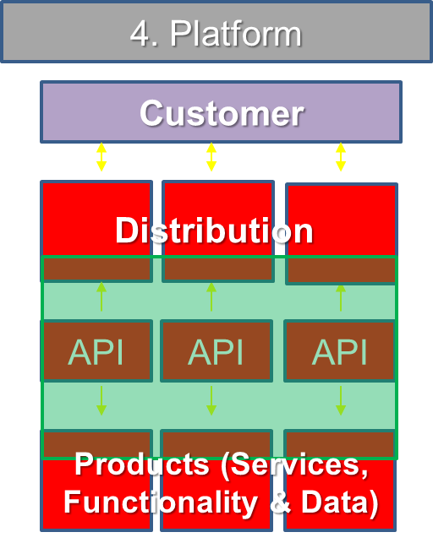
Opportunity: Four potential roles in the financial value chain
A platform (as a ‘business model’) facilitates the business of others by acting as an intermediary. This is often referred to as ‘peer-to-peer’ business. As a platform, banks could offer the following capabilities: matching of parties, security, Know Your Customer (KYC), etc. the bank does not act as a provider or distributor, but as a facilitator for third parties and their customers. Peer-to-peer or platform business does not affect the balance sheet of a bank.
Bank
3rd Party

Slide 6
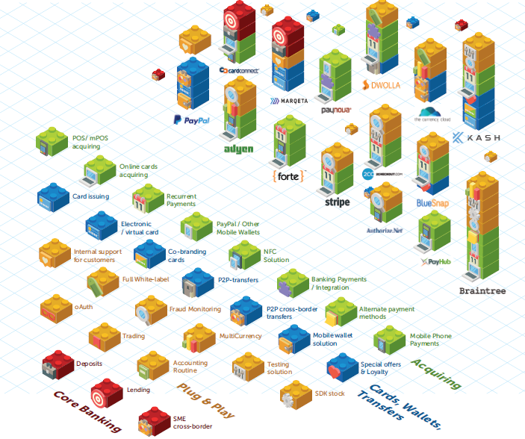
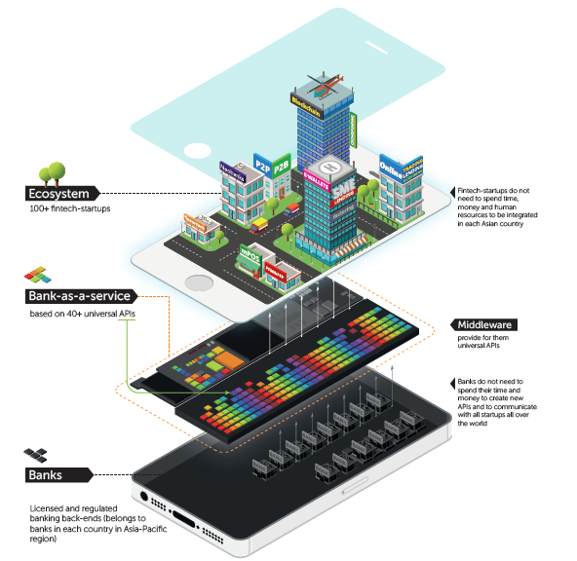
Types of fintech APIs – What is possible to Plug & Play

Slide 7
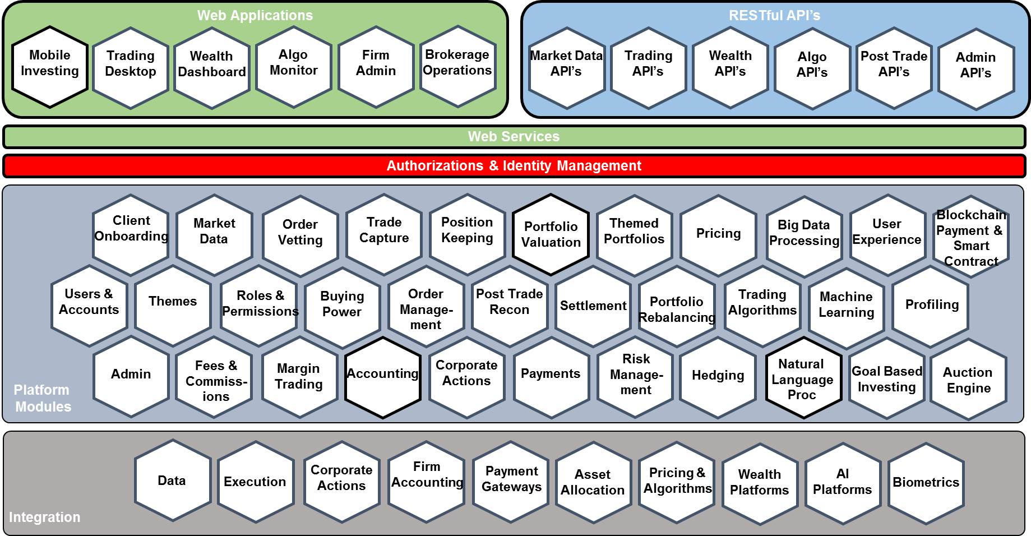

Plug & Play Modules and APIs combined to create full business solutions

Slide 8
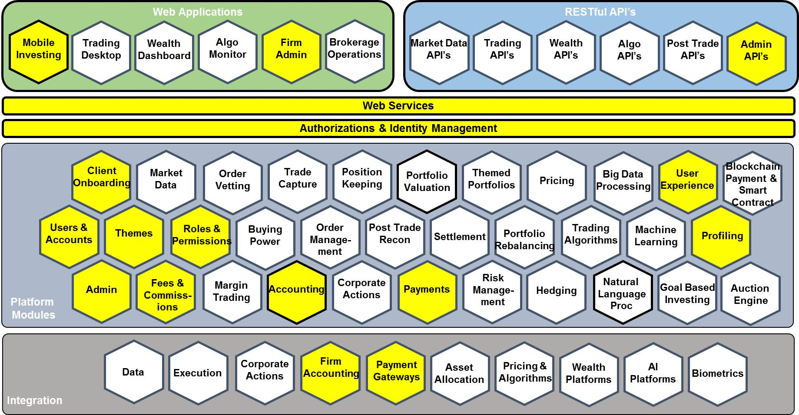
Plug & Play Modules and APIs combined to create MicroFinance Platform

Slide 9
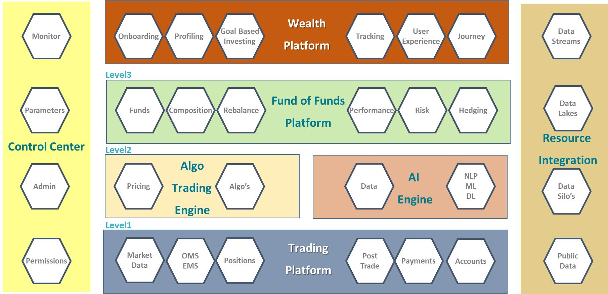
Plug & Play Modules & APIs combined to create Wealth & Trading Platform

Slide 10



Wealth Management: Robo-advisor is poised for exponential growth
Robo 1.0
Robo 2.0
Robo 3.0
Present-Future model: Fully automated service combining chatbot, automatic rebalancing, fractional ownership, nudging, back-testing and strategies underpinned by algos. Blockchain, artificial intelligence, machine learning coupled with big data.
Most prevalent form of Robo today where clients portfolios get built based on a short online survey. The portfolio construction strategies use underlying ETF baskets weighted between stocks, bonds and gold.
Hybrid model whereby artificial intelligence supports the advice and decision making of an adviser. Particularly potent for estate and tax planning.

Slide 11






Wealth Management: Robo-advisor is poised for exponential growth
Goal-based financial planning tools for clients
Advisor financial planning tools
Tax optimization (e.g. tax loss harvesting)
Democratizing
6. Automated advice has become so cheap it is available to everyone
Account aggregation tools for clients
Advisor contact management tools
Robo-advice
is here today
Demonetizing
5. Advice is free, like an app on your smartphone
Dematerializing
4. Add on of big data, predictive algorithmic analytics, cognitive computing, etc. More complex. More holistic advice is automated
Pure AI/ML Robo 3.0
Disruptive
3. Well funded players invest in robo- advice and combine it with human advice. Assets are ready to move
Communication & collaboration tools
Deceptive
Digitalized
2. A lot of hype but incumbents ignore it
1. Advice begins to be digitalized
Prospect engagement tools
Online account opening
Source: Deloitte, Robo-Advisors – Industry Changes or Also-Runs, 2015

Slide 12
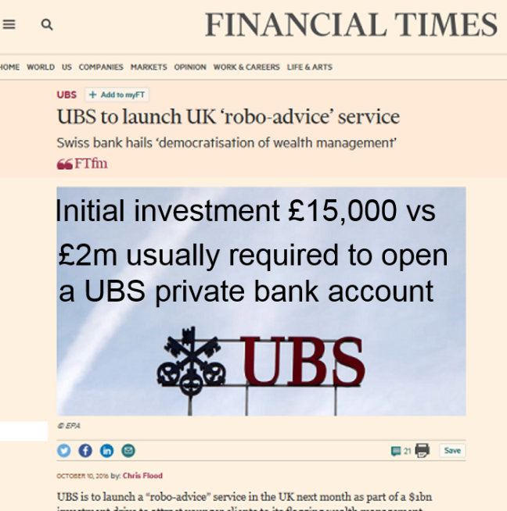
Adopters of robo-advisory services
will be primarily targeting the Mass Market
Notes:
UBS has invested about $1bn to redesign all of the processes across its wealth management operations.
https://www.ft.com/content/684bc4c2-8a39-11e6-8cb7-e7ada1d123b1

Slide 13
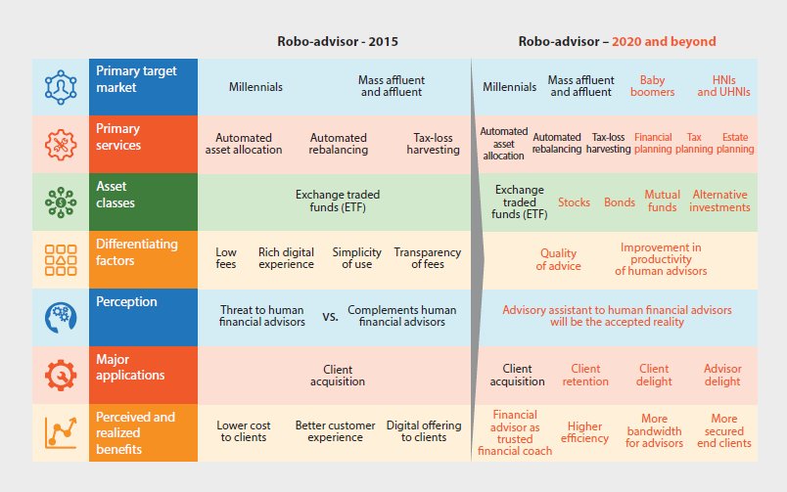
Allocating Resources – The Rise of Robo-Advice
Source: Infosys, “Increasing the Efficiency and Effectiveness of Financial Advice with Robo-Advisors”, 2016

Slide 14
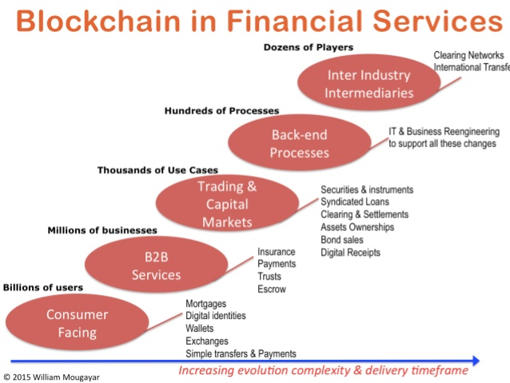
The FinTech Conundrum –
Competitive, Collaborative, and a compelling investment environment

Slide 15
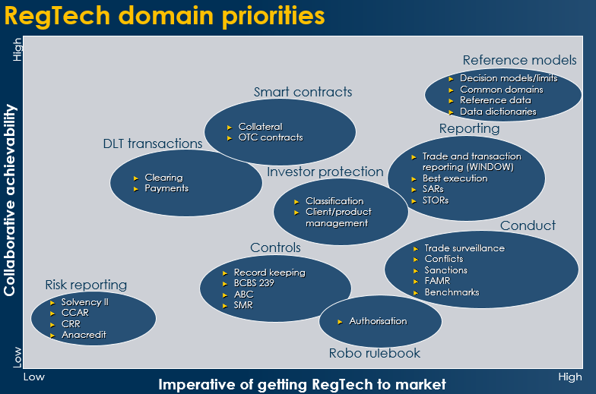
RegTech Priorities
Blockchain
(DLT – Distributed Ledger Technology
Robo

Slide 16
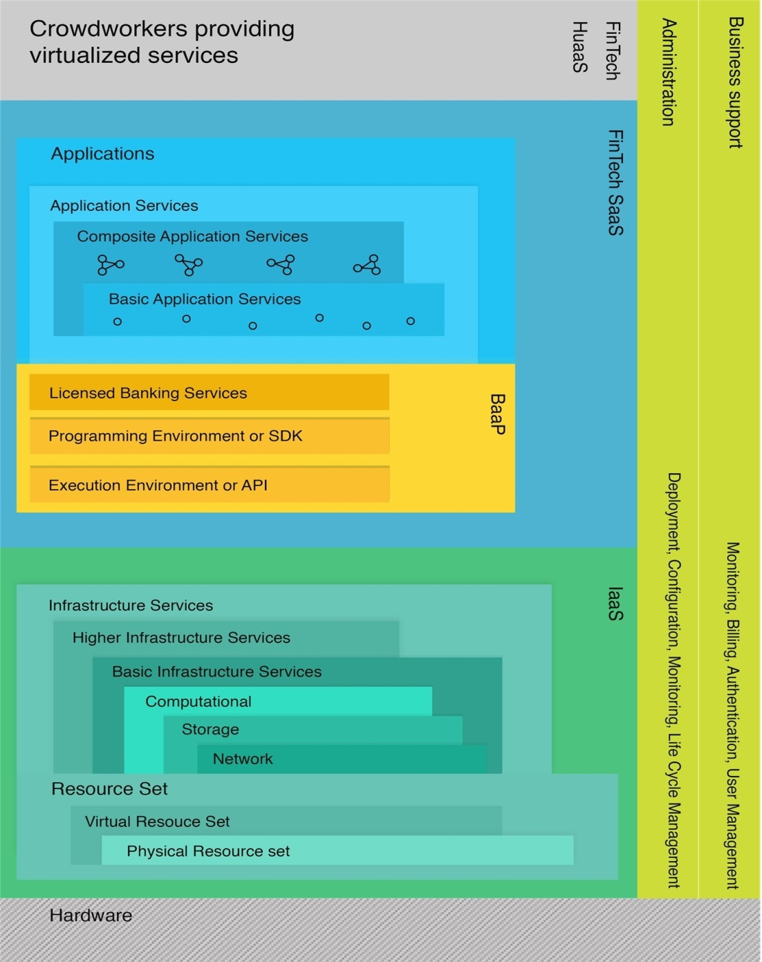
The Opportunity: Radical Architectural Shift to FinTech-driven As-a-Service Banking
BaaP Cloud
(Bank as a Platform)
FinTech SaaS
FinTech SaaS are all atomic or composite software-based financial services which are made available on-demand.
BaaP would either be a fully licensed bank or would include external licensed banking services of a classical regulated bank.
On this Banking-as-a-Platform layer, are the decomposed banking services, simply "plugged in".
Traditional banking services could be virtualized (surrounded by some Cloud-service wrapping) and provisioned within a composite application service. In contrast to the infrastructure services from the IaaS layer below, these FinTech application services are centered about banking and finance.

Slide 17


Cloud-based Transformation in Financial Services
Production cloud
2
Development & test cloud
1
Internal channels
Channel service integration
Service bus
Other business systems
Core business systems
Development cloud
Test cloud
Outlets
Integrated front-end system
Self-service devices
Transaction management
Funds
Development tool
UAT compilation environment
E-banking
Intermediate business platform
Card management
Credit
Development framework
Development/ST compilation environment
Risk management
Payment
Application architecture and template
Source code configuration server
Mobile banking
Telephone banking
Anti-money laundering
Deposit
Credit management
Ledger
Cloud platform
Cloud platform
Data transmission platform
IaaS (infrastructure cloud service)
External channels
Payments
Data integration
IaaS (infrastructure cloud service)
Data warehouse
Big Data platform
Content management platform
Computing
Network
Storage
Computing
Network
Storage
FinTech
Apps as a Service
Business management
Electronic image data
Wealth Management
Asset liability management
Financial management
Reports & Statistics
3
Converged data warehouse cloud
Notes:
To help financial institutions implement cloud-based transformations, Huawei has launched three solutions:
Production cloud solution that employs an elastic architecture to handle high concurrency (concurrent access by numerous users)
Converged data warehouse solution that helps financial institutions conduct precise marketing and monitor risks in real time
Development and test cloud solution that helps financial institutions accelerate service system rollout and gain a competitive edge over competitors

Slide 18
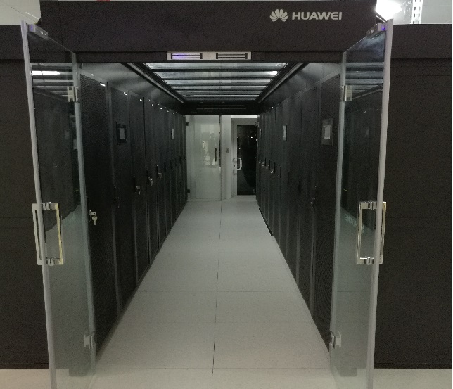


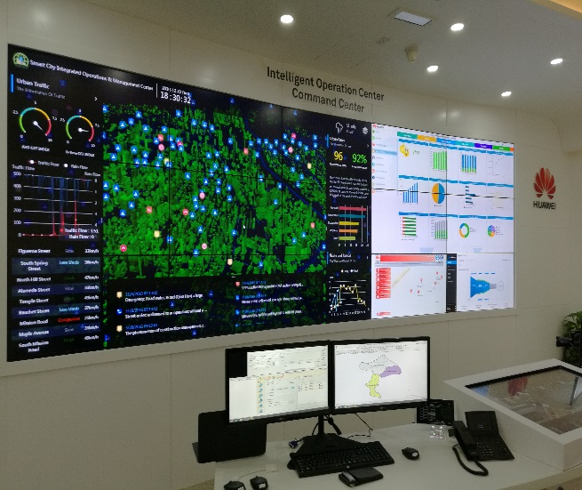
Huawei OpenLab Dubai Innovates New ICT with Clients and ISV Partners
Verification
Centre
Technical Support
Centre
Joint Innovation Centre
Experience Centre
  Comprehensive range of devices
  VPN-based encryption remote commissioning
  Huawei eSDK customization
  Online development support
  Joint development of industry solutions
  Joint solutions pilot
  Experiencing innovative achievements
  Sharing success stories
  Solutions showcases

